Slide 1

Clustering
Unsupervised learning
Machine Learning
Slides from CS-229 by Andrew Ng

Slide 2
Supervised learning
Price
(in 1000s of dollars)
Size (feet²)
Training set:

Slide 3



Unsupervised learning
Training set:

Slide 4
Unsupervised learning
Training set:

Slide 5
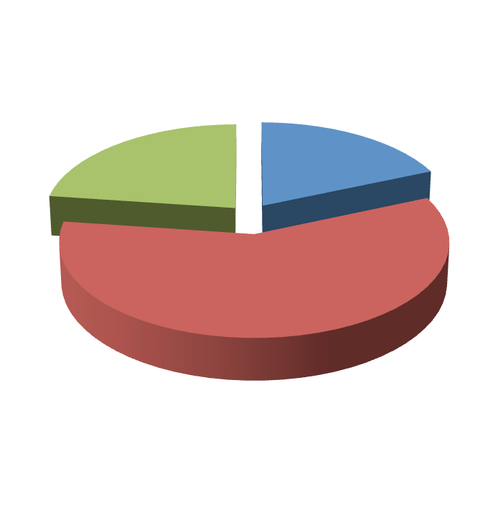








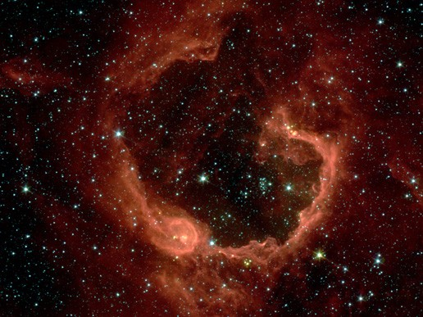
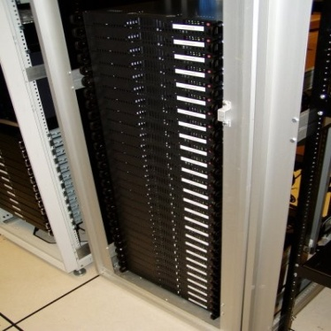
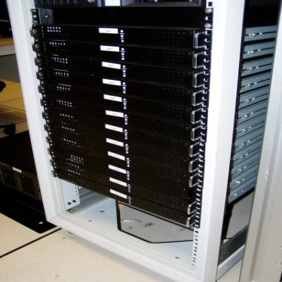
Applications of clustering
Market segmentation
Social network analysis
Image credit: NASA/JPL-­‐Caltech/E. Churchwell (Univ. of Wisconsin, Madison)
Organize computing clusters
Astronomical data analysis

Slide 6
Clustering K-­ means algorithm
Machine Learning

Slide 7
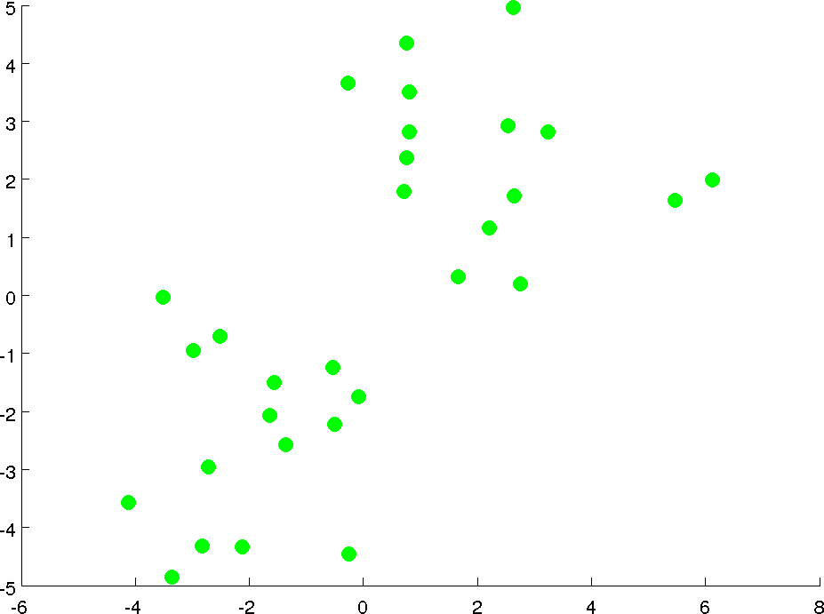

Slide 8
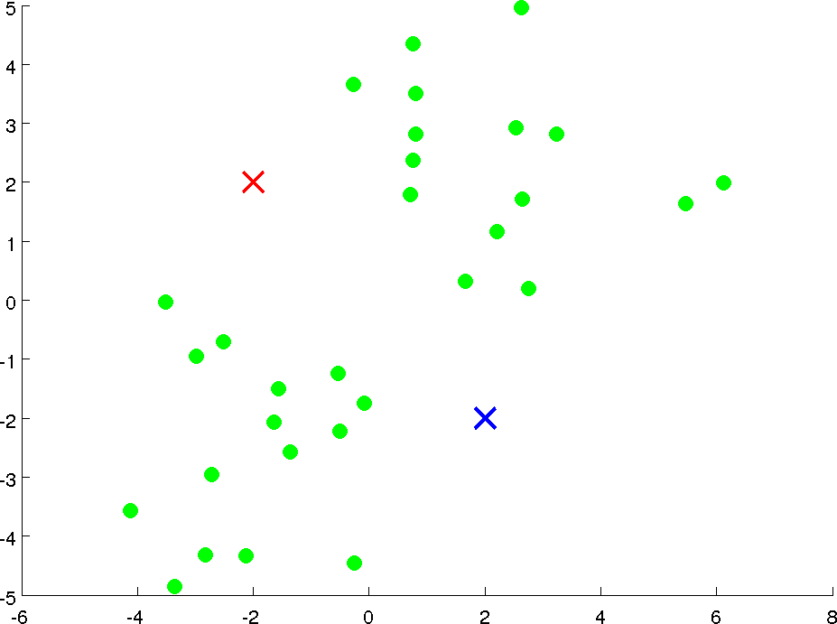






Slide 9
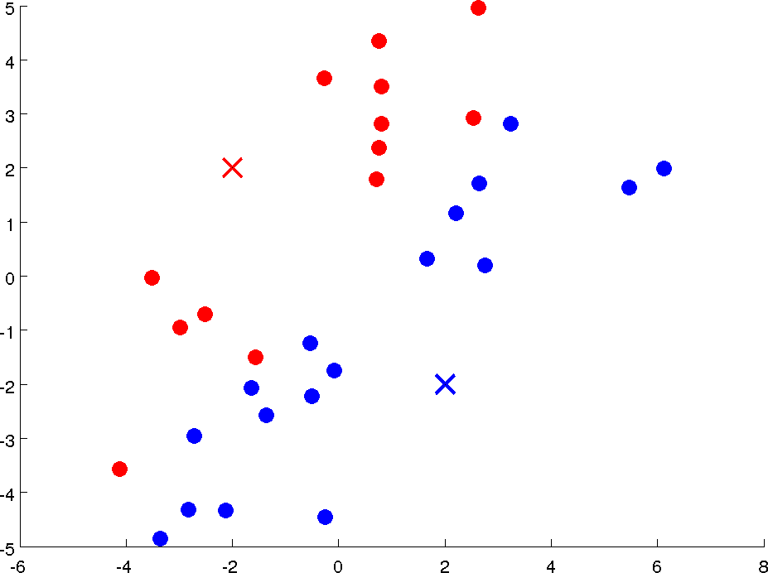

Slide 10
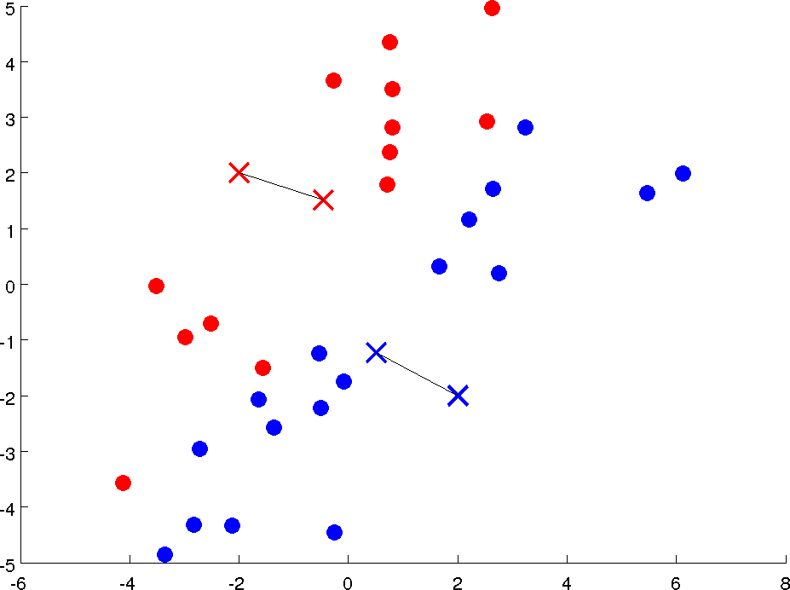




Slide 11
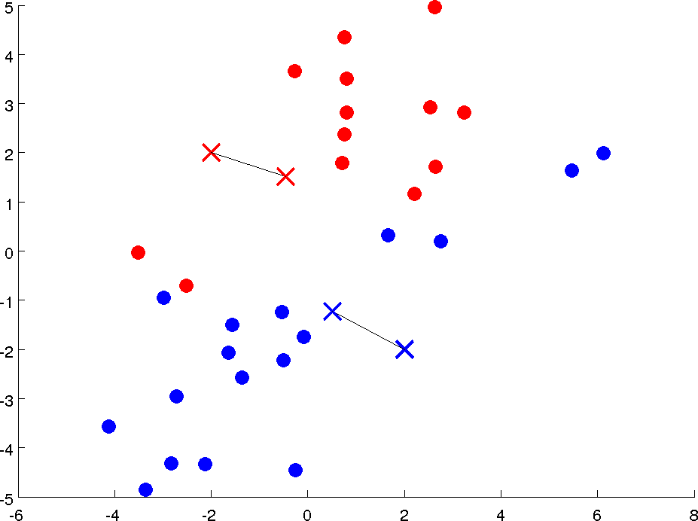

Slide 12
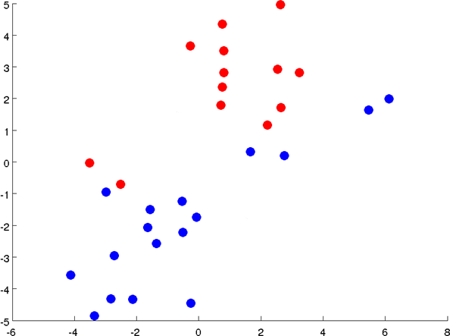

Slide 13
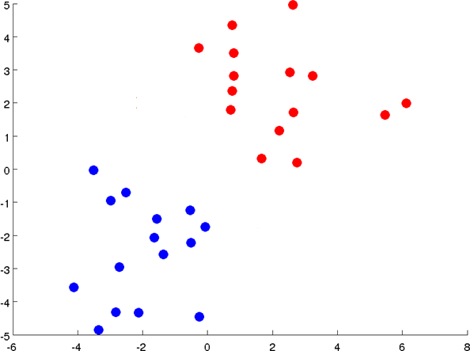

Slide 16

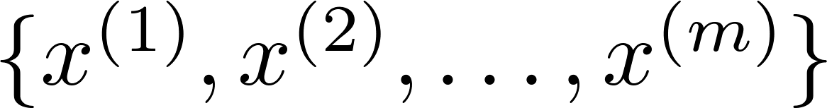


K-­‐means algorithm
Input:
-­‐ (number of clusters)
-­‐ Training set
(drop
convention)

Slide 17

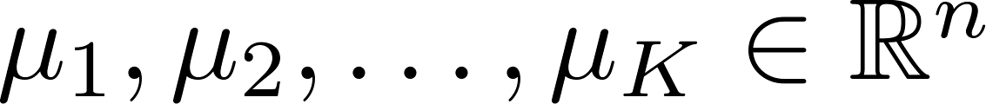



K-­‐means algorithm
Randomly initialize cluster centroids Repeat {
for = 1 to
:= index (from 1 to closest to
) of cluster centroid
for = 1 to
:= average (mean) of points assigned to cluster
}

Slide 18
K-­‐means algorithm
Randomly initialize cluster centroids Repeat {
(i) Cluster Assignment
for = 1 to
:= index (from 1 to closest to
) of cluster centroid
for = 1 to
:= average (mean) of points assigned to cluster
}

Slide 19
K-­‐means algorithm
Randomly initialize cluster centroids Repeat {
(i) Cluster Assignment
for = 1 to
:= index (from 1 to closest to
) of cluster centroid
for = 1 to
:= average (mean) of points assigned to cluster
}
(ii) Move Centroids

Slide 20
K-­‐means algorithm
Randomly initialize cluster centroids Repeat {
(i) Cluster Assignment
for = 1 to
:= index (from 1 to closest to
) of cluster centroid
for = 1 to
:= average (mean) of points assigned to cluster
}

Slide 21



K-­‐means algorithm
Randomly initialize cluster centroids Repeat {
for = 1 to
:= index (from 1 to closest to
) of cluster centroid
for = 1 to
:= average (mean) of points assigned to cluster
}

Slide 22
K-­‐means algorithm
Randomly initialize cluster centroids Repeat {
for = 1 to
:= index (from 1 to closest to
) of cluster centroid
for = 1 to
:= average (mean) of points assigned to cluster
}
(ii) Move Centroids

Slide 23


















K-­‐means algorithm
Randomly initialize cluster centroids Repeat {
for = 1 to
:= index (from 1 to closest to
) of cluster centroid
for = 1 to
:= average (mean) of points assigned to cluster
}

Slide 24
K-­‐means algorithm
Randomly initialize cluster centroids Repeat {
for = 1 to
:= index (from 1 to closest to
) of cluster centroid
for = 1 to
:= average (mean) of points assigned to cluster
}

Slide 25
K-­‐means algorithm
Q1. What will be the optimization objective?
Q2. How will that be minimized?

Slide 26
Clustering Optimization objective
Machine Learning

Slide 27






K-­‐means optimization objective
= index of cluster (1,2,…, ) to which example assigned
= cluster centroid ( )
= cluster centroid of cluster to which example assigned
is currently
has been

Slide 28
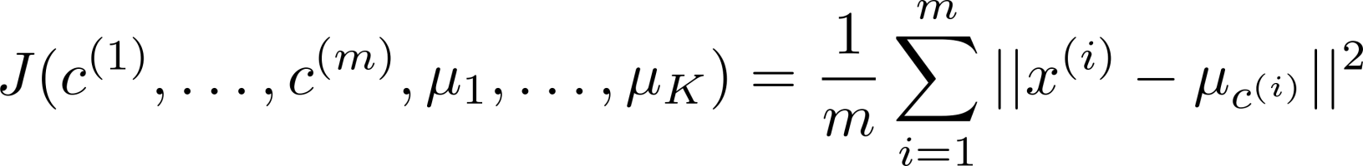
K-­‐means optimization objective
= index of cluster (1,2,…, ) to which example assigned
= cluster centroid ( )
= cluster centroid of cluster to which example assigned
is currently
has been
Optimization objective:

Slide 29
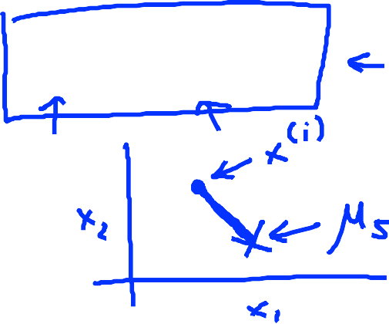
K-­‐means optimization objective
= index of cluster (1,2,…, ) to which example assigned
= cluster centroid ( )
= cluster centroid of cluster to which example assigned
is currently
has been
Optimization objective:

Slide 30
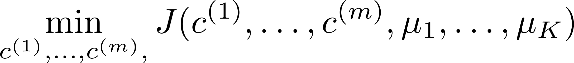

K-­‐means optimization objective
= index of cluster (1,2,…, ) to which example assigned
= cluster centroid ( )
= cluster centroid of cluster to which example assigned
is currently
has been
Optimization objective:

Slide 31
K-­‐means optimization objective
= index of cluster (1,2,…, ) to which example assigned
= cluster centroid ( )
= cluster centroid of cluster to which example assigned
is currently
has been
Distortion
Optimization objective:

Slide 32
K-­‐means optimization objective
= index of cluster (1,2,…, ) to which example assigned
= cluster centroid ( )
= cluster centroid of cluster to which example assigned
is currently
has been
Distortion
Optimization objective:
How to minimize?

Slide 33
K-­‐means algorithm
Q1. What will be the optimization objective?
Q2. How will that be minimized?

Slide 34
K-­‐means algorithm
Randomly initialize cluster centroids
Repeat {
for = 1 to
:= index (from 1 to closest to
) of cluster centroid
for = 1 to
:= average (mean) of points assigned to cluster
}

Slide 35
K-­‐means algorithm
Randomly initialize cluster centroids
Repeat {
(i) Cluster Assignment
for = 1 to
:= index (from 1 to closest to
) of cluster centroid
for = 1 to
:= average (mean) of points assigned to cluster
}
(ii) Move Centroids

Slide 36
K-­‐means algorithm
Randomly initialize cluster centroids
Repeat {
(i) Cluster Assignment
for = 1 to
:= index (from 1 to closest to
) of cluster centroid
for = 1 to
:= average (mean) of points assigned to cluster
}

Slide 37

K-­‐means algorithm
Randomly initialize cluster centroids
Repeat {
Minimize $J\left(…\right)$ w.r.t $c^{1}, c^{2}, …,c^{m}$
(holding $μ_{1},μ_{2}, …,μ_{K}$ fixed)
(i) Cluster Assignment
for = 1 to
:= index (from 1 to closest to
) of cluster centroid
for = 1 to
:= average (mean) of points assigned to cluster
}

Slide 38
K-­‐means algorithm
Randomly initialize cluster centroids
Repeat {
for = 1 to
:= index (from 1 to closest to
) of cluster centroid
for = 1 to
:= average (mean) of points assigned to cluster
}
(ii) Move Centroids

Slide 39

K-­‐means algorithm
Randomly initialize cluster centroids
Repeat {
for = 1 to
:= index (from 1 to closest to
) of cluster centroid
for = 1 to
:= average (mean) of points assigned to cluster
}
Minimize $J\left(…\right)$ w.r.t $μ_{1},μ_{2}, …,μ_{K}$
(holding $c^{1}, c^{2}, …,c^{m}$ fixed)
(ii) Move Centroids

Slide 40
K-­‐means algorithm
Randomly initialize cluster centroids
Repeat {
Minimize $J\left(…\right)$ w.r.t $c^{1}, c^{2}, …,c^{m}$
(holding $μ_{1},μ_{2}, …,μ_{K}$ fixed)
(i) Cluster Assignment
for = 1 to
:= index (from 1 to closest to
) of cluster centroid
for = 1 to
:= average (mean) of points assigned to cluster
}
Minimize $J\left(…\right)$ w.r.t $μ_{1},μ_{2}, …,μ_{K}$
(holding $c^{1}, c^{2}, …,c^{m}$ fixed)
(ii) Move Centroids

Slide 41
K-­‐means optimization objective
= index of cluster (1,2,…, ) to which example assigned
= cluster centroid ( )
= cluster centroid of cluster to which example assigned
is currently
has been
Distortion
Optimization objective:
How to minimize?

Slide 42
Clustering Random initialization
Machine Learning

Slide 43


K-­‐means algorithm
Randomly initialize cluster centroids
Repeat {
for = 1 to
:= index (from 1 to closest to
) of cluster centroid
for = 1 to
:= average (mean) of points assigned to cluster
}

Slide 44


Random initialization
Should have
Randomly pick training examples.
Set equal to these examples.

Slide 45

Random initialization
Should have
Randomly pick training examples.
Set equal to these examples.
$$K=2$$

Slide 46
Random initialization
Should have
Randomly pick training examples.
Set equal to these examples.
$$K=2$$

Slide 47

Random initialization
Should have
Randomly pick training examples.
Set equal to these examples.
$$K=2$$
$$μ_{1}=x^{(i)}$$
$$μ_{2}=x^{(j)}$$

Slide 48
Random initialization
Should have
Randomly pick training examples.
Set equal to these examples.
$$K=2$$
$$μ_{1}=x^{(i)}$$
$$μ_{2}=x^{(j)}$$

Slide 49

Random initialization
Should have
Randomly pick training examples.
Set equal to these examples.
$$K=2$$
Local Optimal
$$μ_{1}=x^{(i)}$$
$$μ_{2}=x^{(j)}$$

Slide 50









Local optima

Slide 51
Local optima

Slide 52
Local optima

Slide 53
Local optima

Slide 54
Local optima
How to avoid local optimal solutions?

Slide 55
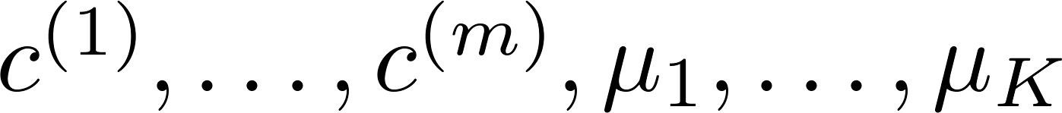
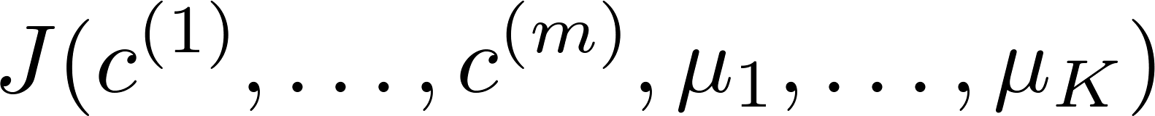
Random initialization
For i = 1 to 100 {
Randomly initialize K-­‐means. Run K-­‐means. Get
Compute cost function (distortion)
}
.
Pick clustering that gave lowest cost

Slide 56
Clustering
Choosing the number of clusters
Machine Learning

Slide 57
What is the right value of K?

Slide 58
What is the right value of K?

Slide 59
What is the right value of K?

Slide 60

Choosing the value of K
Elbow method:
Cost function
Cost function
1 2 3 4 5 6 7 8
(no. of clusters)
1 2 3 4 5 6 7 8
(no. of clusters)

Slide 61
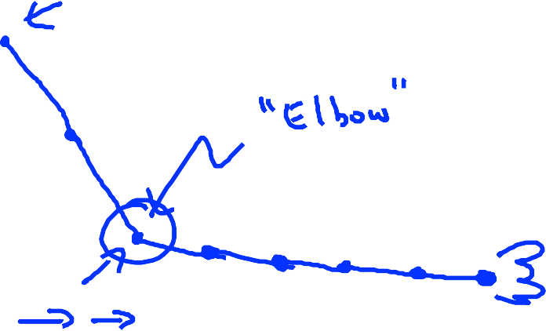
Choosing the value of K
Elbow method:
Cost function
Cost function
1 2 3 4 5 6 7 8
(no. of clusters)
1 2 3 4 5 6 7 8
(no. of clusters)

Slide 62
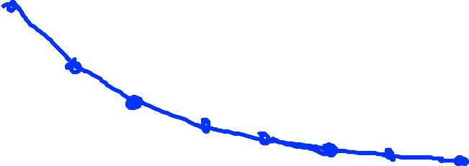
Choosing the value of K
Elbow method:
Cost function
Cost function
1 2 3 4 5 6 7 8
(no. of clusters)
1 2 3 4 5 6 7 8
(no. of clusters)

Slide 63
Choosing the value of K
Sometimes, you’re running K-­‐means to get clusters to use for some later/downstream purpose. Evaluate K-­‐means based on a metric for how well it performs for that later purpose.
E.g.
T-­‐shirt sizing
T-­‐shirt sizing
Weight
Weight
Height
Height

Slide 64

Choosing the value of K
Sometimes, you’re running K-­‐means to get clusters to use for some later/downstream purpose. Evaluate K-­‐means based on a metric for how well it performs for that later purpose.
$K=3;$ S, M, L
E.g.
T-­‐shirt sizing
T-­‐shirt sizing
Weight
Weight
Height
Height

Slide 65
Choosing the value of K
Sometimes, you’re running K-­‐means to get clusters to use for some later/downstream purpose. Evaluate K-­‐means based on a metric for how well it performs for that later purpose.
$K=3;$ S, M, L
E.g.
T-­‐shirt sizing
T-­‐shirt sizing
Weight
Weight
Height
Height

Slide 66
Choosing the value of K
Sometimes, you’re running K-­‐means to get clusters to use for some later/downstream purpose. Evaluate K-­‐means based on a metric for how well it performs for that later purpose.
$K=3;$ S, M, L
L
E.g.
T-­‐shirt sizing
T-­‐shirt sizing
M
S
Weight
Weight
Height
Height

Slide 67
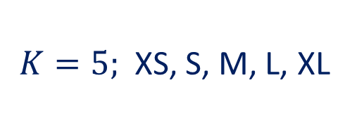
Choosing the value of K
Sometimes, you’re running K-­‐means to get clusters to use for some later/downstream purpose. Evaluate K-­‐means based on a metric for how well it performs for that later purpose.
$K=3;$ S, M, L
$K=5;$ XS, S, M, L, XL
L
E.g.
T-­‐shirt sizing
T-­‐shirt sizing
M
S
Weight
Weight
Height
Height

Slide 68
Choosing the value of K
Sometimes, you’re running K-­‐means to get clusters to use for some later/downstream purpose. Evaluate K-­‐means based on a metric for how well it performs for that later purpose.
$K=3;$ S, M, L
$K=5;$ XS, S, M, L, XL
L
E.g.
T-­‐shirt sizing
T-­‐shirt sizing
M
S
Weight
Weight
Height
Height

Slide 69
Choosing the value of K
Sometimes, you’re running K-­‐means to get clusters to use for some later/downstream purpose. Evaluate K-­‐means based on a metric for how well it performs for that later purpose.
$K=3;$ S, M, L
$K=5;$ XS, S, M, L, XL
L
E.g.
T-­‐shirt sizing
T-­‐shirt sizing
XL
M
L
M
S
Weight
Weight
S
XS
Height
Height

Slide 70
K-­‐means in detail with examples
https://jakevdp.github.io/PythonDataScienceHandbook/05.11-k-means.html

